Slide 1
Khalid Iqbal
(1929-2014)
“Art in Pakistan”
BFA-IV (Visual Arts)
Class Incharge: Ms. Farah Khan
Institute of Design & Visual Arts, LCWU

Slide 2
Khalid Iqbal
Following traditional and modern concepts of art, innovative work on subjective and stylistic patterning of Pakistani art started seriously soon after independence of the country. In this context, painter and educationist Prof. Khalid Iqbal’s role is also important like other renowned artists. Landscapists especially hold him in high regard.
Based in Lahore, the family had to shift due to posting of Khalid Iqbal’s father in Simla. He was born there in 1929 and then, whenever his father was out of Lahore on official duty, Khalid accompanied him. He once said: “During my early age, I travelled a lot with my father”. However, he came back home at the time of Independence in 1947 after passing Senior Cambridge Examination from St. Joseph’s Academy, Dehra Dun. He then pursued an intermediate education at Government College, Lahore.
Khalid Iqbal never claims that he is a born artist. He says, “I don’t remember having any interest in art. What I remember is that I loved to see the many faces of nature and its relationship with man”

Slide 3
Khalid Iqbal
At that time, people still harbored reservations about Masters in Arts. Such thinking was natural because art had yet to carve a niche as a paying profession. For most people, it was just a hobby or a pastime. Despite an air of pessimism, teachers continued their efforts to turn it into a reputable profession.
For some time Khalid Iqbal attended art classes at Mayo School of Art in the evening to learn the basics of art. He once shared:
“Ghulam Nabi Malik was the Principal of Mayo School of Art ahen I got a chance to study. Very soon, I found myself becoming part of the activity going on there. Ustad Muhammad Latif Chughtai’s way of teaching drawing and painting was very impressive and communicative. He enabled me to see, draw and color objects accurately according to the principles of art. Unfortunately, before completing this course, I had to discontinue my studies. Nevertheless, I was learning art very seriously”

Slide 4
Khalid Iqbal
In 1949, Khalid Iqbal did his graduation from the University of the Punjab, Lahore, in Economics and Political Science. The same year he was offered an art teachers job at Aitcheson College, Lahore which he accepted very reluctantly. He shared:
“Getting this job came as a bit of a surprise because I had very little to do with this subject. But, this way, Allah put me back on the track of art”
Listening to ex-President of Pakistan Farooq Ahmed Khan Leghari’s speech, on the occasion of NCA’s Convocation, one could learn how strick a teacher Khalid Iqbal was. Mr Leghari said: “I remember my art teacher Khalid Iqbal who failed me in the subject taught by him when I was studying at Aitcheson. I think he did rightly because I was not fully prepared for his paper”.
Pakistan’s emergence as asovereign state ushered in an era of change. Khalid Iqbal observed this whole new socio-political scene and was proud to be a part of it. Besides teaching art classes at Aitcheson College, he roamed about in and around his beloved city and painted what ever attracted him.

Slide 5
Khalid Iqbal
The next significant change in Khalid Iqbal’s artistic career occurred when he was seen painting on the spot in Murre by founder of the Department of Fine Arts at the University of the Punjab, Anna Molka Ahmed, Appreciating his creative approach to art, she advised him to go to London for acquiring higher knowledge in the field of painting. Considering her sincere advice and realizing that art-education of that level was not available in Pakistan, he went to London and studied at Slade School of Art from 1952 to 1955. At Slade, he studied art under the guidance of Sir William Menzies Coldstream who was head of the school and one of the founders of Euston Road Group.
Interestingly, in the late 1930’s, “Some British painters who had previously been experimenting with abstract art were turning to a lyrical and restrained realistic style of painting with tones of simplicity. Rejecting the modernist theories of abstraction and surrealism, they reverted to a quiet and intimate art of commonplace themes---landscapes, still life, portraits and nudes. The trend was crystallized at the Euston Road School whose founders were influenced by literary and political trends towards relevance and exactness with emphases on the factual and anti-romantic and they preferred delicate richness and clarity to emphatic colors or expressive distortions” (Harold Osborne-Twentieth Century Art)

Slide 6
Khalid Iqbal
What Khalid Iqbal was painting at home was not at all abstract. Neither was he inclined to express things in this idiom. Anna Molka Ahmed had appreciated his art because of its socio-cultural relevance. At Slade, besides working on his course assignments, imbibing impressions of masters of realistic idiom like Constable, Van Gogh or Cezanne, Khalid Iqbal found himself inspired by Coldstream and the manifesto of Euston Road School.
In 1955, equipped with a diploma from Slade, Khalid Iqbal landed back in Lahore and was appointed Lecturer of Fine Arts at the University of the Punjab. At that time the Department of Fine Arts was running under the Chairmanship of Anna Molka Ahmed and course of studies for Master in Fine Arts for boys was just launched. He had brought with him in his baggage a landscape painting, which could remind him of what he had been studying under the guidance of Coldstream at Slade.
Khalid Iqbal had a taste for literature. Before, going to London, he met with Saadat Hassan Manto. Now, he had both writer and artists friends including Shakir Ali, Moyene Najmi, Habib Jalib, Zainul Abidin, Nasir Kazmi, Sheikh Ahmed, Taufiq Riffat, Nawab Natiq and Kamal Ahmed Rizvi.

Slide 7
Khalid Iqbal
It’s a misconception that before the advent of the British Raj forms like landscapes, portraits, still life or nudes didn’t exist in our art. Early impression of these forms can easily be traced through history. In traditional art, for instance at the time of the Mughals, painters very consciously made landscape a pleasant part of their paintings while illustrating public and private life accounts of emperors and wealthy courtiers.
Similarly, other forms also got full subjective independence now under western influence. Trained at Slade, Khalid Iqbal’s art too appeared influenced by western traditions, particularly with reference to nineteenth century landscape art.
After his return from Britain in 1955, using western techniques, Khalid Iqbal expressed his socio-cultural ideas simultaneously in landscape, portrait and still life and became one of the first modern realist painters of Pakistan. In 1965, after teaching art at the University of the Punjab for about ten years, he chooses to head the faculty of Fine Arts at the National College of Arts (NCA).

Slide 8
Khalid Iqbal
He imparted art education at NCA according to the newly constructed system and became a favorite among his students. Besides performing his teaching job, he was also anxious to paint. But, long hours of official duty, left him little time to paint on the spot.
In 1981, before reaching the age of retirement, he decided to give up his professorship at NCA. He said: “The decision to say good-bye to my job was for living with art according to my will”
To be a painter has always been more important for him. He says, “Rather than wasting time on fashionably overrating myself as some kind of intellectual, I prefer to remain what I am, a painter. Because, I believe, its one’s purposeful creative art which makes one important in the history”.
Throughout his entire artistic career, he has been studying the aesthetic relationship of art with reality and creating in oil medium all that has pleased his senses in the colorful environment of Lahore; particularly with reference to landscape and its various seasonal effects and moods.

Slide 9
Khalid Iqbal
Working in the genre of landscape, (unlike Ustad Allah Buksh’s romantic way of seeing and painting the socio-cultural life and environment of rural Punjab), he appears to concentrate on his style in the realistic idiom for painting the existing, changing and vanishing visions and sensations of Lahore’s natural beauty. Very soon, not only his impressions in this form succeeded in attracting viewers but they also earned him encouragement, appreciation and the reputation of being a modern landscapist.
In an innovative manner, rather than creating snap-shot effects of his beloved subject matter i.e., familiar scenes of landscape of rural and suburban areas of Lahore. Khalid Iqbal has always been interested in using his palette for capturing effects of sunlight and shadows, and conveying sensations produced by the landscape. Thematically, the relationship between man and nature as depicted by him thoughtfully and intellectually can be seen in his paintings. For instance, the changing faces of buildings and disappearing representatives of indigenous trees became a dominant character of Khalid Iqbal’s visual vocabulary. And ultimately, in the total silence, happy and sad whisperings of trees can be sensed saying one thing only: “Nature serves you beauty and love”

Slide 10
Khalid Iqbal
Like Coldstream, conceptually and technically, Khalid Iqbal’s landscape has been a dominant source of inspiration for many who take interest in this form. In 1977, he won Pakistan National Council of the Art’s Quaid-i-Azam Award in Painting. In 1980, he was awarded Pride of Performance Award in Paintings by the Government of Pakistan. He also accepted Chair of Professor Emeritus at the National College of Arts, Lahore in 1993.
He never had a Solo Show during his life, but participated in group shows. Following his death, in 2004 National College of Arts published a book “Khalid Iqbal- A pioneer of Modern Realism in Pakistan” by Musarrat Hassan to pay tribute to Prof. Khalid Iqbal. On the occasion of book launching ceremony, admirers of his work were able to see the long-awaited Solo Show of his paintings at NCA which was considered to be close to the reality with emphasis on capturing atmosphere as he felt at the time of painting on the spot. He selects and paints those spots which normally do not strike to a common eye, but his unusual approach and skillful handling makes the same spot very important in his painting.

Slide 11
Conclusion
Khalid Iqbal, painted many excellent portraits and still life paintings in the earlier part of his long career but later he devoted himself wholly to landscape painting. He brought about a remarkable change in the principle of observation of nature and its interpretation with colors. He developed a style of his own in landscape painting, which he practiced all his life and inspired others. He brought realism to painting with impressionistic treatment of color and light, thus creating a realistic atmosphere in his landscapes. Many of his paintings are almost devoid of human activity and rarely contain human figures. They are purely visual world of landscapes reflecting creative, technique and passion leaving viewers in trance who enjoy and listen to great symphony of nature. He creates interesting and eye catching effects through simplification of forms, brushwork, careful composition and use of light and subdue colors according to requirements of the subject.
Renowned artist Saeed Akhtar said at his death: “Khalid Iqbal’s death is a great loss for the art of painting in our country, especially landscape painting. He revived landscape painting and brought back its traditional touch”.

Slide 12
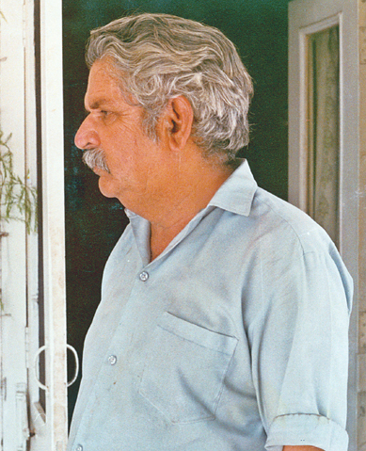
Khalid Iqbal, the man himself

Slide 13
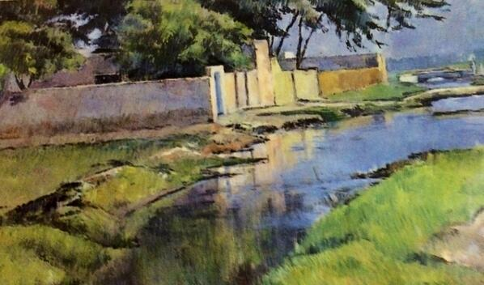
Untitled

Slide 14
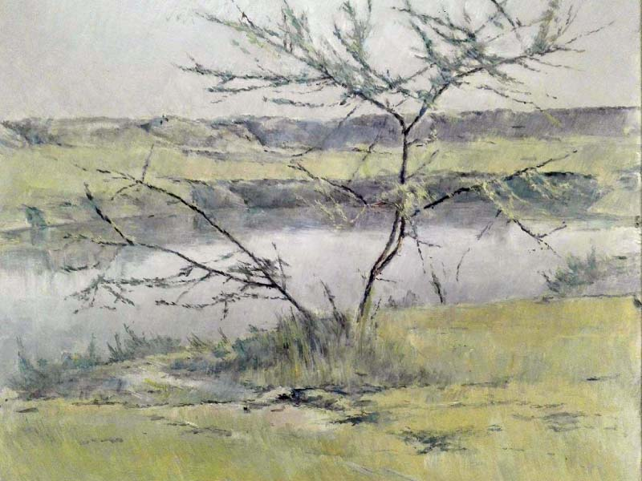
Untitled

Slide 15
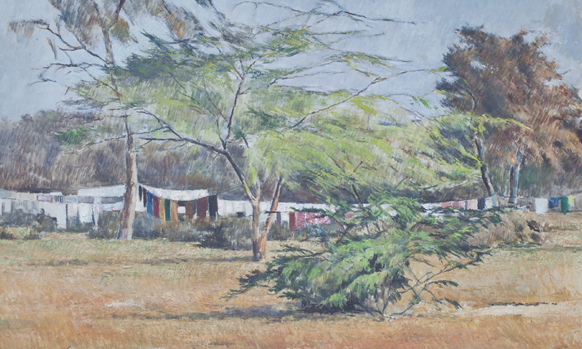
Untitled

Slide 16
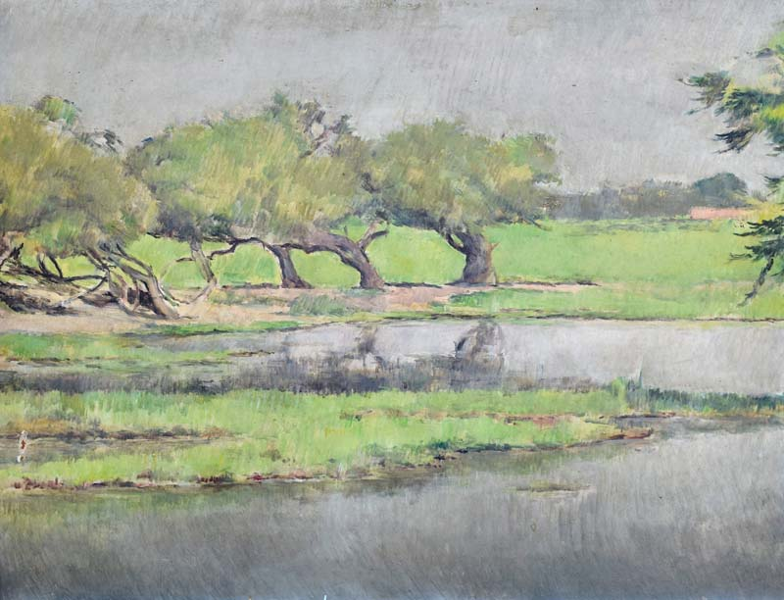
Untitled

Slide 17
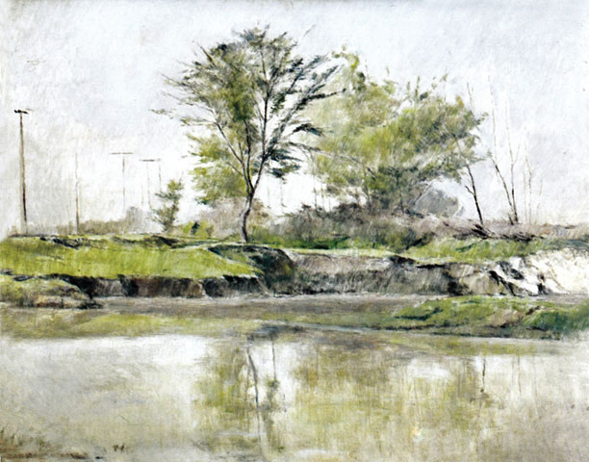
Untitled

Slide 18
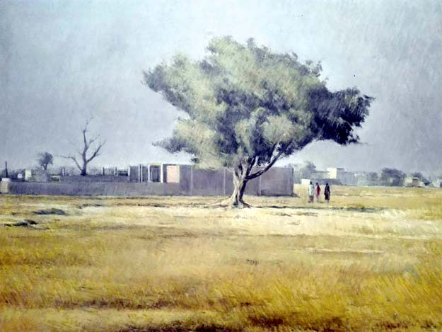
Untitled

Slide 19
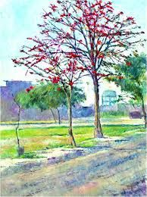
Untitled

Slide 20
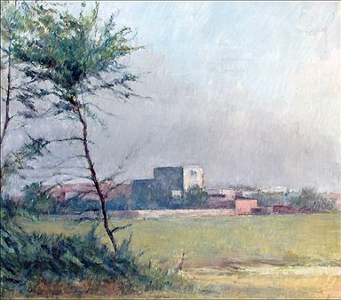
Untitled

Slide 21
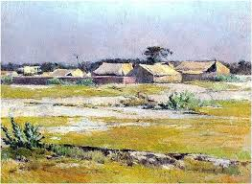
Untitled

Slide 22
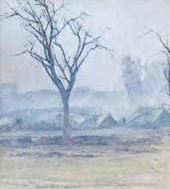
Untitled

Slide 23
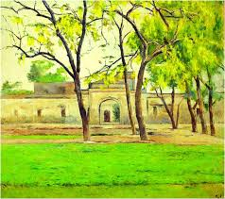
Untitled

Slide 24
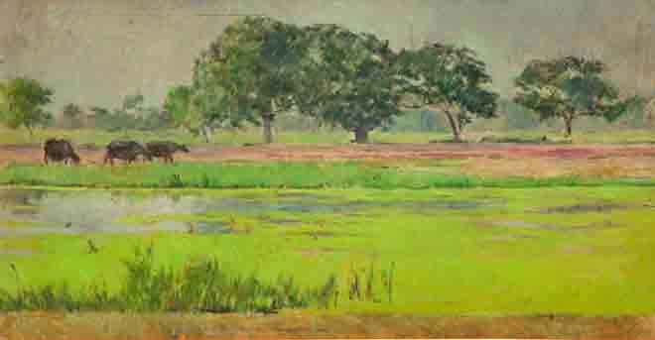
Untitled

Slide 25
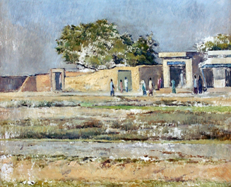
Untitled

Slide 26
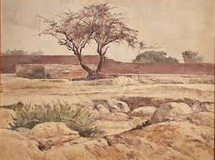
Untitled

Slide 27
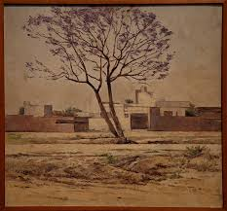
Untitled

Slide 28
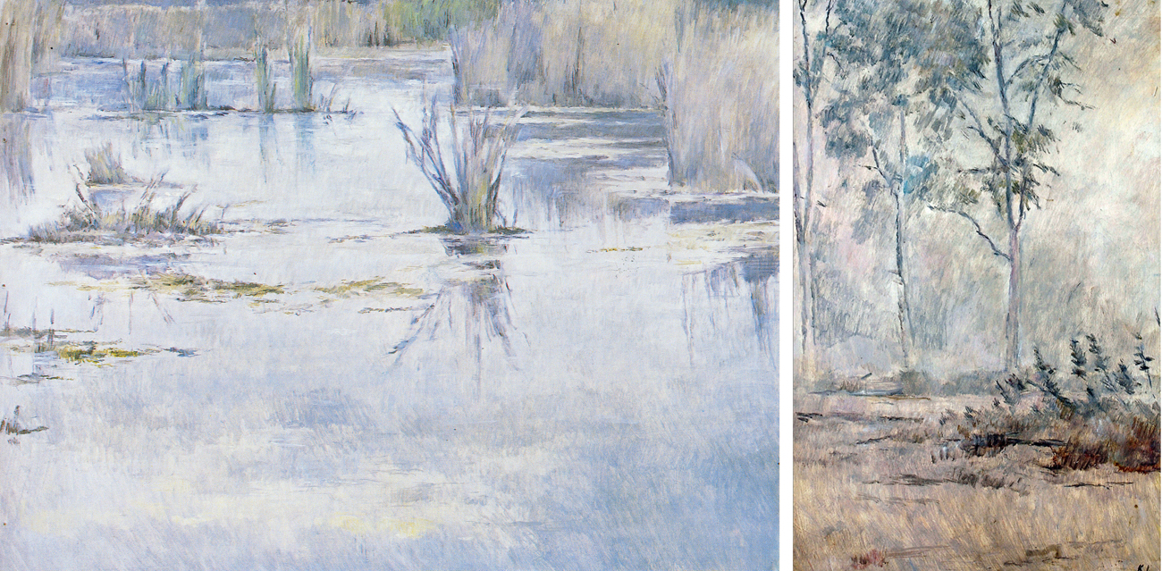
Untitled

Slide 29
Untitled

Slide 30
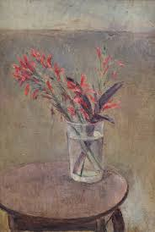
Untitled

Slide 31
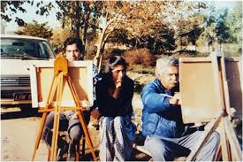
Khalid Iqbal while teaching his students

